Slide 1
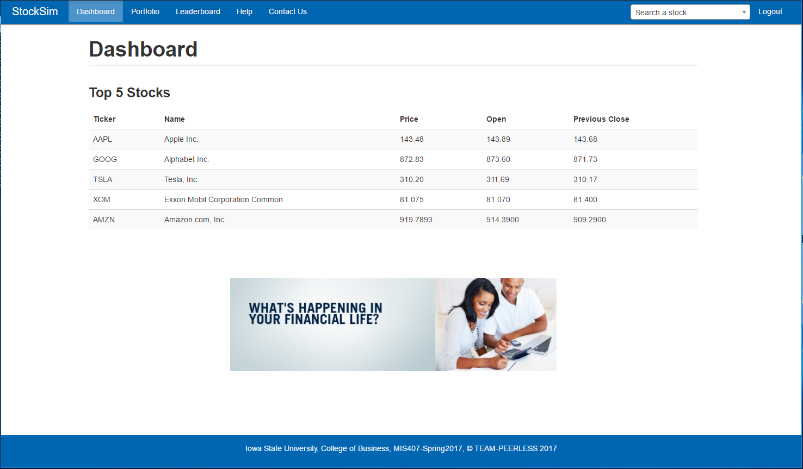
Place your screenshot here
StockSim
By: Team Peerless

Slide 2
Team Peerless
Jesse Espinoza - Frontend Developer
Nathaniel Hinshaw - Developer
Teddy Reinert - Backend Developer
Pritam Shyam - Documentation
David Jennings - Documentation
Matt Rafalko - Documentation

Slide 3
Agenda
Scope
Project Value
Revenue Stream
Functionality
StockCoin
Application Flowchart
StockSim Demo
Conclusion

Slide 4
Scope
Stock Simulation Web-based
NASDAQ
Competition Between Users
Financial Analysis
Real Time Historical Graphs
Free & Premium Accounts
Free is open to everyone

Slide 5

Project Value
Educate Students about Stock Market
Boosting Financial Literacy
America scores 63%

Slide 6
Revenue Stream
Subscriptions
Monthly $9.99
Semi-Annual $49.99
Annually $99.99
Advertisements
Banners & Popups
Sponsor Promotions
Educational Videos
Licensing
Semester or Full-Term
Negotiable Pricing
Student Discount

Slide 7
Functionality
Buy/Sell/Trade Stocks
Financial analysis
Leaderboard - Classroom, friends or individuals compete

Slide 8
StockCoin
Cryptocurrency
Premium Account Holders
Certain Rate of Return %
In-house Solution
Proof-of-Stake
Future Release

Slide 9
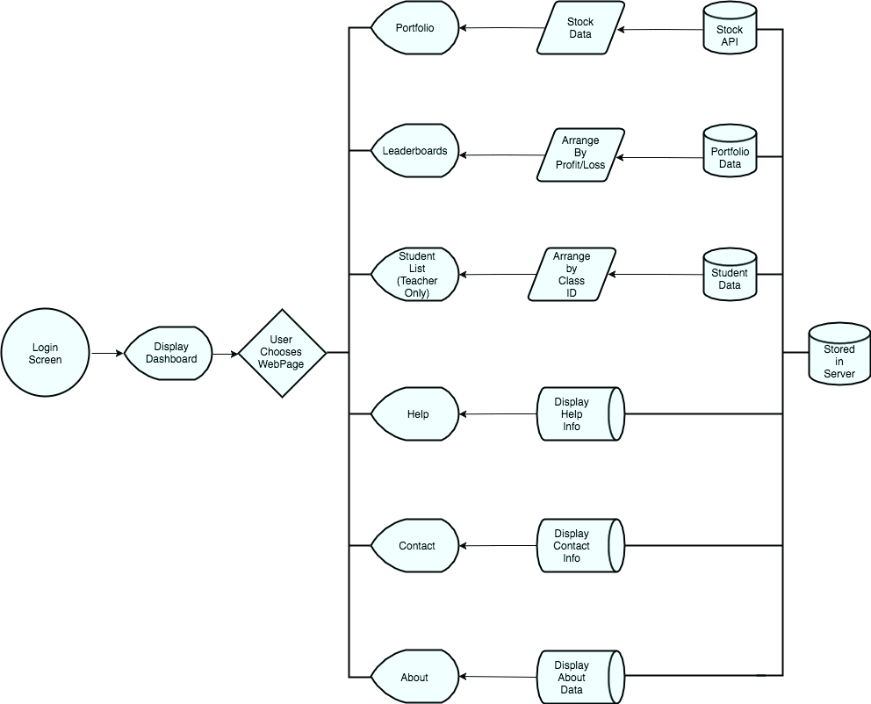
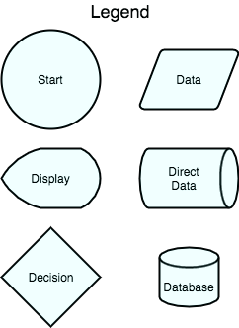
Application Flowchart

Slide 10
Backend
SQLite 3
DBTools
All SQL in one file
“Master Module”
Yahoo Finance
Real Time Stock Info
Plotly for historical

Slide 11
Frontend
Flask
Jquery + Javascript
HTML5 + CSS3
Twitter Bootstrap

Slide 12
StockSim Demo
Website

Slide 13
Next Steps
Further the educational benefit
Guided tutorials
Expand Educational Resources
Functionality
More trading options
Short/Cover
Incorporate NYSE stocks
Increase apps exposure to educational institutions
Premium Functionality

Slide 14
Conclusion
Questions?

